Slide 1






Foundations of
Quantum Information Science (QIS 101)
Dave Biersach
Brookhaven National Laboratory
dbiersach@bnl.gov
Session 13
Fourier Analysis

Slide 2
Session 13 – Goals
Perform Fourier Analysis using the Discrete Fourier Transform (DFT)
Perform Fourier Synthesis using the Inverse Discrete Fourier Transform (IDFT)
Investigate radio transmissions received from deep space
Determine the fundamental frequency of Sunspot Activity
Use the DFT to remove high frequency interference
Consider the DFT of a damped oscillator
Correlate the Heisenberg Uncertainty Principle to the Fourier Transform

Slide 3
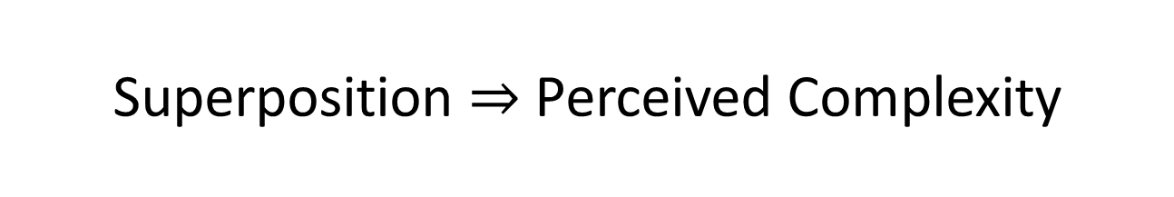
Superposition $⇒$ Perceived Complexity
What appears to be a complicated waveform might be just a series of simple waves all added together (in a linear superposition)
Underneath the perceived random behavior of a function undergoing wild fluctuations might be a system of straightforward waves
These simple waves may individually convey some important knowledge about the true nature of the observed complexity
The process of determining the underlying simple waveforms that make up a complicated wave is called Fourier Analysis

Slide 4
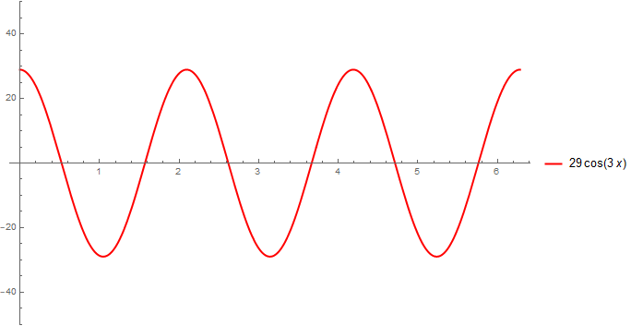
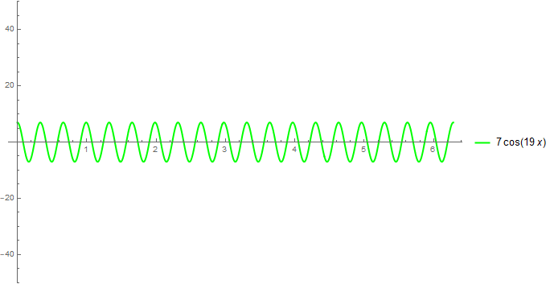
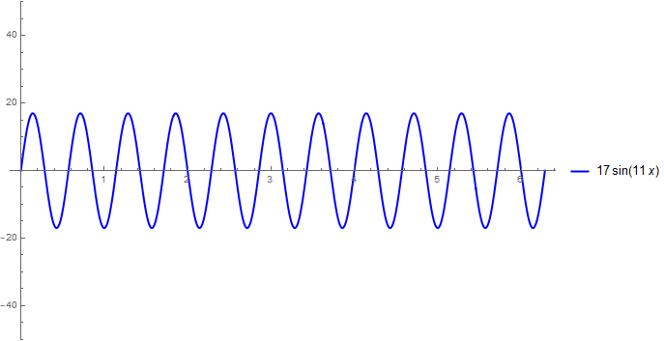
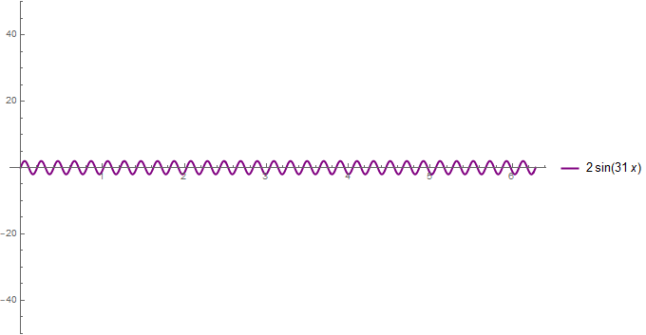
Superposition $⇒$ Perceived Complexity
Wave #1
Wave #3
Wave #2
Wave #4

Slide 5
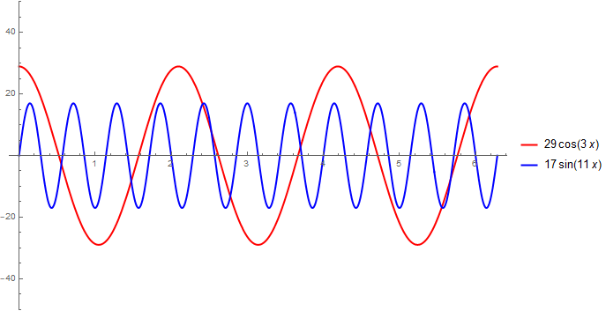
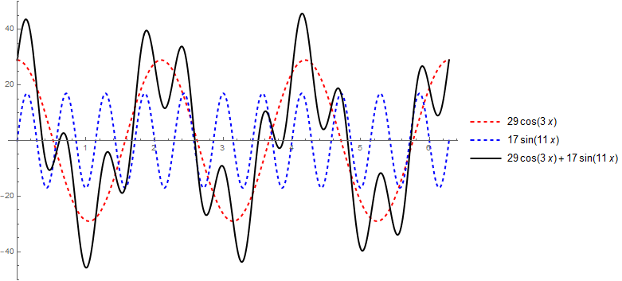
Superposition $⇒$ Perceived Complexity
Wave #1
Wave #1 & #2
Wave #1 + #2
Wave #2

Slide 6
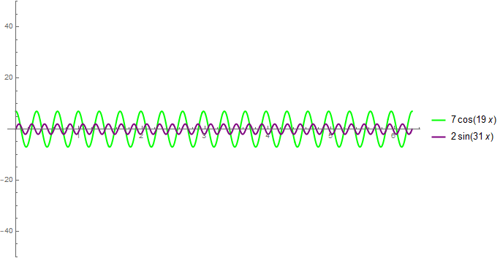
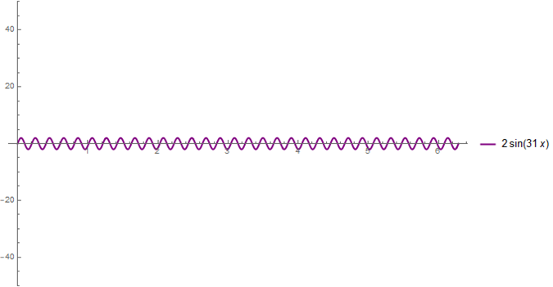
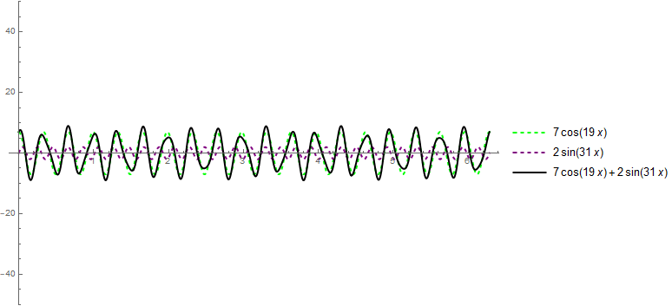
Superposition $⇒$ Perceived Complexity
Wave #3
Wave #3 & #4
Wave #3 + #4
Wave #4

Slide 7
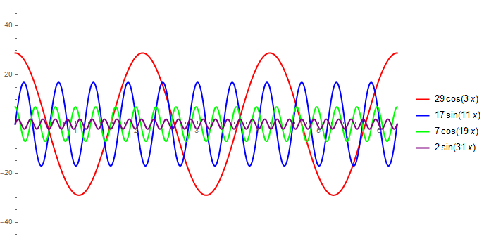
Superposition $⇒$ Perceived Complexity
Waves #1 & #2 & #3 & #4

Slide 8
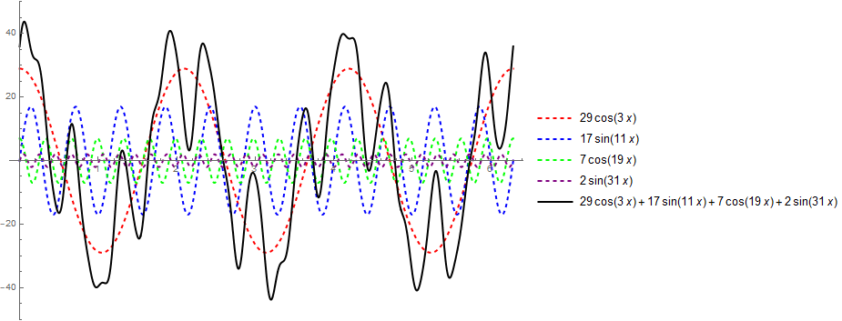
Superposition $⇒$ Perceived Complexity
Waves #1 + #2 + #3 + #4

Slide 9
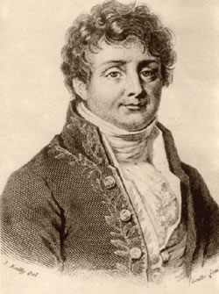
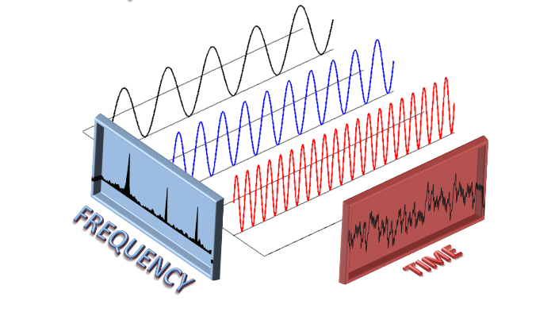
Fourier Transform
Continuous and Discrete
Jean-Baptiste Fourier (1768-1830)
both r’s are silent
“Foo-yay”

Slide 10
Fourier Analysis
Converting a complicated wave into a series of simple waves having potentially fractional amplitudes but integer frequencies is called the Fourier Transform
The reverse process of reconstructing the original complicated wave by summing all the contributions of the simple waves is called the Inverse Fourier Transform
It is a transform because we are converting back and forth between representing a wave as a sum of amplitudes over time versus a sum of amplitudes over integer frequencies
It is two sides of the same mirror – both approaches equally describe the same wave – but the frequency view often reveals hidden patterns in the wave

Slide 11
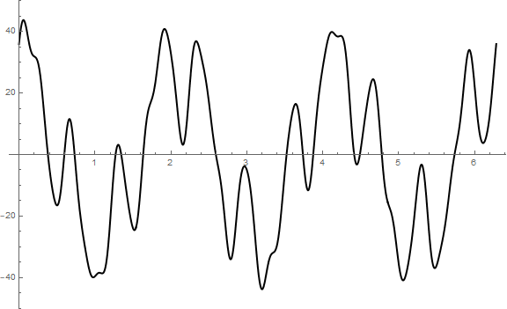
Fourier Analysis
$$y\left(x\right)=29\cos\left(3x\right)+17\sin\left(11x\right)+7\cos\left(19x\right)+2\sin\left(31x\right)$$
…how can we determine each "term" (each simple wave) in the superposition?
Given a complicated wave…

Slide 12
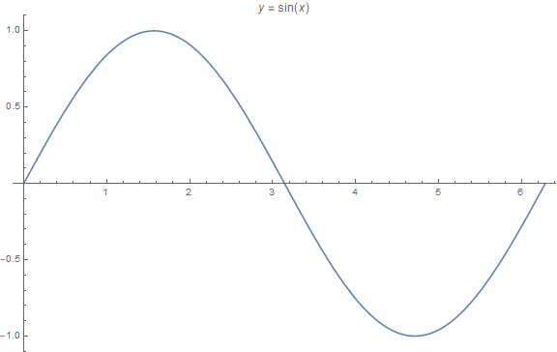
Fourier Analysis - Intuition
$$0 ≤x <2π$$
$$\int_{0}^{2π}{\sin\left(x\right)dx=0}$$

Slide 13
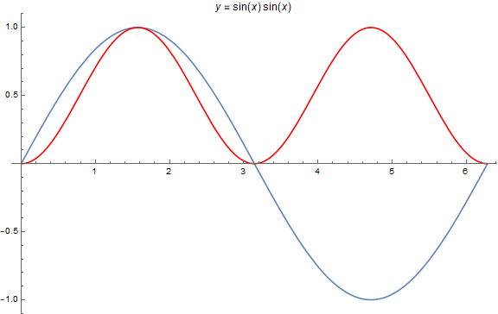
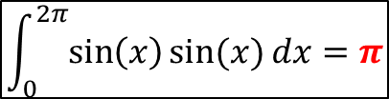
Fourier Analysis - Intuition
$$\int_{0}^{2π}{\sin\left(x\right)\sin{(x)}dx=π}$$

Slide 14
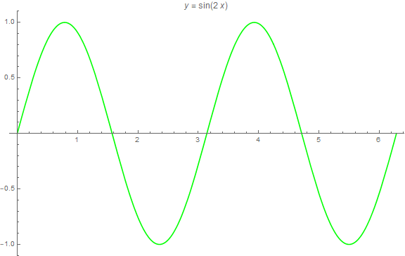
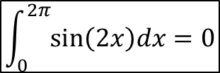
Fourier Analysis - Intuition
$$\int_{0}^{2π}{\sin\left(2x\right)dx=0}$$

Slide 15
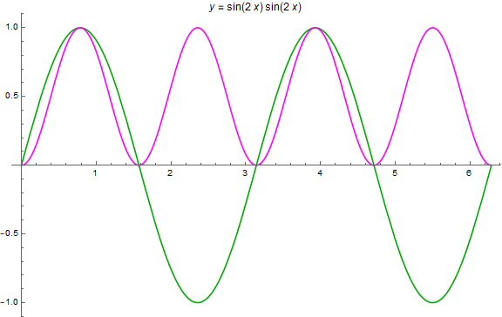
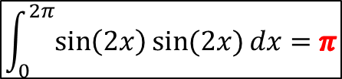
Fourier Analysis - Intuition
$$\int_{0}^{2π}{\sin\left(2x\right)\sin{(2x)}dx=π}$$

Slide 16
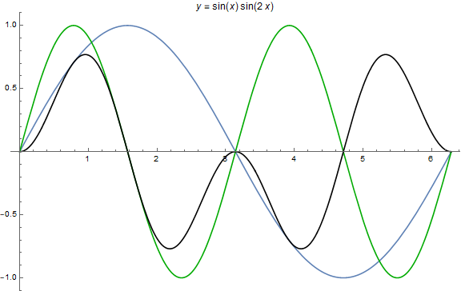
Fourier Analysis - Intuition
$$\int_{0}^{2π}{\sin\left(x\right)\sin{(2x)}dx=0}$$

Slide 17
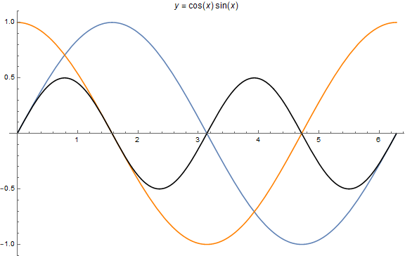
Fourier Analysis - Intuition
$$\int_{0}^{2π}{\cos\left(x\right){\sin{(x)}dx}=0}$$

Slide 18
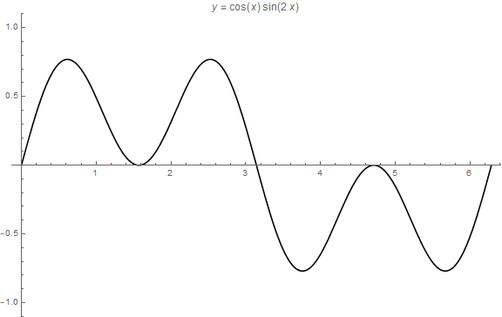
Fourier Analysis - Intuition
$$\int_{0}^{2π}{\cos\left(x\right){\sin{(2x)}dx}=0}$$

Slide 19
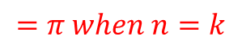
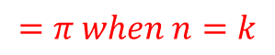
Fourier Analysis - Intuition
$$\int_{0}^{2π}{\sin{(kt)\sin\left(nt\right)dt}}$$
$$=π when n=k$$
$$=0 when n≠k$$
The only time the integral of the product of two sinusoids is > 0 is when both waves have matching frequency and phase
$$\int_{0}^{2π}{\cos{(kt)\cos\left(nt\right)dt}}$$
$$=π when n=k$$
$$=0 when n≠k$$
$$\int_{0}^{2π}{\cos{(kt)\sin\left(nt\right)dt}}$$
$$=0 when n=k$$
$$=0 when n≠k$$

Slide 20
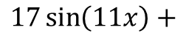
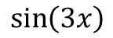
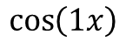
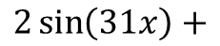
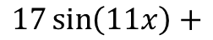
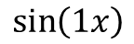
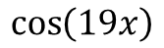
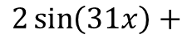
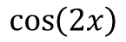
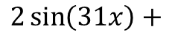
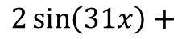
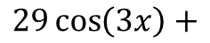
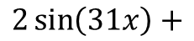
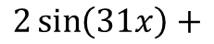
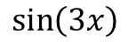
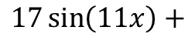
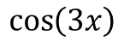
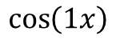
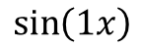
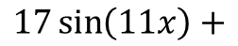
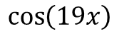
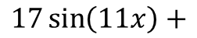
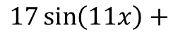

















































Fourier Analysis
$$\int_{0}^{2π}{y\left(x\right)f(x)}=\int_{0}^{2π}{\left[29\cos\left(3x\right)+17\sin\left(11x\right)+7\cos\left(19x\right)+2\sin\left(31x\right)\right]f(x)}$$
Filter Wave
Complicated Wave
$$\cos\left(1x\right)$$
$$29\cos\left(3x\right)+$$
$$\sin\left(1x\right)$$
$$29\cos\left(3x\right)+$$
$$\sin\left(11x\right)$$
$$29\cos\left(3x\right)+$$
$$\cos\left(1x\right)$$
$$17\sin\left(11x\right)+$$
$$\sin\left(1x\right)$$
$$17\sin\left(11x\right)+$$
$$\sin\left(11x\right)$$
$$17\sin\left(11x\right)+$$
$$\cos\left(1x\right)$$
$$7\cos\left(19x\right)+$$
$$\sin\left(1x\right)$$
$$7\cos\left(19x\right)+$$
$$\sin\left(11x\right)$$
$$7\cos\left(19x\right)+$$
$$\cos\left(1x\right)$$
$$2\sin\left(31x\right)+$$
$$\sin\left(1x\right)$$
$$2\sin\left(31x\right)+$$
$$\sin\left(11x\right)$$
$$2\sin\left(31x\right)+$$
$$\cos\left(2x\right)$$
$$29\cos\left(3x\right)+$$
$$\sin\left(2x\right)$$
$$29\cos\left(3x\right)+$$
$$\cos\left(19x\right)$$
$$29\cos\left(3x\right)+$$
$$\cos\left(2x\right)$$
$$17\sin\left(11x\right)+$$
$$\sin\left(2x\right)$$
$$17\sin\left(11x\right)+$$
$$\cos\left(19x\right)$$
$$17\sin\left(11x\right)+$$
$$\cos\left(2x\right)$$
$$7\cos\left(19x\right)+$$
$$\sin\left(2x\right)$$
$$7\cos\left(19x\right)+$$
$$\cos\left(19x\right)$$
$$7\cos\left(19x\right)+$$
$$\cos\left(2x\right)$$
$$2\sin\left(31x\right)+$$
$$\sin\left(2x\right)$$
$$2\sin\left(31x\right)+$$
$$\cos\left(19x\right)$$
$$2\sin\left(31x\right)+$$
$$\cos\left(3x\right)$$
$$29\cos\left(3x\right)+$$
$$\sin\left(3x\right)$$
$$29\cos\left(3x\right)+$$
$$\sin\left(31x\right)$$
$$29\cos\left(3x\right)+$$
$$\cos\left(3x\right)$$
$$17\sin\left(11x\right)+$$
$$\sin\left(3x\right)$$
$$17\sin\left(11x\right)+$$
$$\sin\left(31x\right)$$
$$17\sin\left(11x\right)+$$
$$\cos\left(3x\right)$$
$$7\cos\left(19x\right)+$$
$$\sin\left(3x\right)$$
$$7\cos\left(19x\right)+$$
$$\sin\left(31x\right)$$
$$7\cos\left(19x\right)+$$
$$\cos\left(3x\right)$$
$$2\sin\left(31x\right)+$$
$$\sin\left(3x\right)$$
$$2\sin\left(31x\right)+$$
$$\sin\left(31x\right)$$
$$2\sin\left(31x\right)+$$

Slide 21






Fourier Analysis
Integral of Sum = Sum of Integrals
$$y\left(x\right)=29\cos\left(3x\right)+17\sin\left(11x\right)+7\cos\left(19x\right)+2\sin\left(31x\right)$$
$$\int_{0}^{2π}{y\left(x\right)ⅆx}=\int_{0}^{2π}{\left(A_{3}\cos\left(3x\right)+B_{11}\sin\left(11x\right)+A_{19}\cos\left(19x\right)+B_{31}\sin\left(31x\right)\right)}ⅆx$$
0
$$\int_{0}^{2π}{y\left(x\right)\cos\left(3x\right)ⅆx}=A_{3}\int_{0}^{2π}{\cos\left(3x\right)\cos\left(3x\right)}ⅆx+B_{11}\int_{0}^{2π}{\sin\left(11x\right)\cos\left(3x\right)}ⅆx+⋯$$
$$\int_{0}^{2π}{y\left(x\right)\cos\left(3x\right)ⅆx}=A_{3}\left(π\right)$$
$$\int_{0}^{2π}{y\left(x\right)\sin\left(11x\right)ⅆx}=B_{11}\left(π\right)$$
See slide #19
$$\int_{0}^{2π}{y\left(x\right)\cos\left(19x\right)ⅆx}=A_{19}\left(π\right)$$
$$\int_{0}^{2π}{y\left(x\right)\sin\left(31x\right)ⅆx}=B_{31}\left(π\right)$$

Slide 22







Fourier Analysis - Intuition
$$\int_{0}^{2π}{\sin{(kt)\sin\left(nt\right)dt}}$$
$$=π when n=k$$
$$=0 when n≠k$$
The only time the integral of the product of two sinusoids is > 0 is when both waves have matching frequency and phase
$$\int_{0}^{2π}{\cos{(kt)\cos\left(nt\right)dt}}$$
$$=π when n=k$$
$$=0 when n≠k$$
$$\int_{0}^{2π}{\cos{(kt)\sin\left(nt\right)dt}}$$
$$=0 when n=k$$
$$=0 when n≠k$$
Only the simple "filter" waves (each having an increasing integer frequency)
that yield a non-zero integral (when multiplied against the "complicated" wave)
can be components of the original wave

Slide 23
Discrete Fourier Analysis
Converting a sampled complicated wave into a series of simple waves, each with different amplitudes at specific integer frequencies, is called the Discrete Fourier Transform (DFT)
The reverse process of reconstructing the original complex wave by summing all the contributing simple wave forms is called the Inverse Discrete Fourier Transform (IDFT)
The sum of many discrete samples of a wave approximates its continuous integral if the spacing (time) between samples is sufficiently small – this is analogous to a Riemann sum

Slide 24













Discrete Fourier Analysis
$$0$$
$$\sum{=y_{0}+y_{1}+⋯+y_{n}}$$
$$2π$$
$$\int_{a}^{b}{f\left(x\right)ⅆx}=\lim_{n→∞}{\sum_{i=1}^{n}{f\left(x_{i}\right)∙Δx}}$$
$$Δx=\frac{b−a}{n},x_{i}=a+Δx∙i$$
$$y_{i}=f\left(x_{i}\right)$$
$$a=0,b=2π→Δx=\frac{2π}{n}$$
Filter
Wave
$$×$$
Complicated
Wave
$$\int{=\left(\sum{ }\right)\frac{2π}{n}}$$
$$\int{=A_{k}π}$$
$$A_{k}π=\left(\sum{ }\right)\frac{2π}{n}$$
$$A_{k}=\frac{2}{n}\sum{f\left(x_{i}\right)}$$

Slide 25








Discrete Fourier Analysis
Filter
Wave
Complicated Wave
0
$$\int_{0}^{2π}{\cos\left(0x\right)\left[A\cos\left(nx\right)+y_{0}\right]ⅆx}$$
$$=\int_{0}^{2π}{(1)A\cos\left(nx\right)ⅆx}+\int_{0}^{2π}{y_{0}ⅆx}=2πy_{0}$$
Offset
$$k>0→\int{=A_{k}π}$$
$$k=0→\int{=2πy_{0}}$$
$$A_{k}=\frac{2}{n}\sum{f\left(x_{i}\right)}$$
$$2πy_{0}=\left(\sum{ }\right)\frac{2π}{n}$$
$$y_{0}=\frac{1}{n}\sum{f\left(x_{i}\right)}$$
$y_{0}$ = Offset = DC

Slide 26





Discrete Fourier Transform (DFT)
DFT (real)
Euler’s Formula
$$𝓎\left(t_{s}\right)≈\sum_{n=0}^{terms}{\left[A_{n}\cos\left(nt_{s}\right)+B_{n}\sin\left(nt_{s}\right)\right]}$$
$$e^{jωt}=\cos{ωt+j\sin{ωt}}$$
$$\cos{ωt}=\frac{1}{2}e^{j\left(−ω\right)t}+\frac{1}{2}e^{jωt}$$
$$A_{0}=\frac{\sum_{s=0}^{samples}{𝓎\left(t_{s}\right)}}{samples}$$
$$\sin{ωt}=\frac{1}{2}e^{j\left(−ω\right)t}−\frac{1}{2}e^{jωt}$$
$$A_{n}=\frac{2\sum_{s=0}^{samples}{𝓎\left(t_{s}\right)\cos\left(nt_{s}\right)}}{samples}$$
DFT (complex)
$$X\left[k\right]=\sum_{n=0}^{N−1}{x\left[n\right]e^{−j2πkn/N}}$$
$$B_{n}=\frac{2\sum_{s=0}^{samples}{𝓎\left(t_{s}\right)\sin\left(nt_{s}\right)}}{samples}$$
Inverse DFT (complex)
$$x\left[n\right]=\frac{1}{N}\sum_{k=0}^{N−1}{X\left[k\right]e^{j2πkn/N}}$$
$$n=term number \{n∈ℤ^{+}\}$$

Slide 27

Launch Jupyter Lab
①
②
③

Slide 28

Open make_samples.ipynb

Slide 29

View make_samples.ipynb
④
We are not normally privy to the underlying formula that generated the complicated wave
①
②
③
⑤
⑥
⑦
⑧

Slide 30



Run Cell 1 - make_samples.ipynb
There is no discernible pattern within the complicated waveform
$$0$$
$$2π$$

Slide 31



Open samples.csv
$$t_{s}=sample time$$
$$y_{s}=sample value$$
The program generated this “comma separated value” (CSV) text file that contains the sampled sinusoid data points

Slide 32
Discrete Fourier Analysis
We now wish to analyze the sample data through the lens of Fourier Analysis
We know that Mother Nature often shows us only her complicated side, and our job as scientists is to unravel those mysteries – to get to the simplicity and beauty hiding behind that complexity
Often the true nature of the underlying physical laws generating the measured data can be better understood by identifying the simple waves that (when in superposition) appear to be a complicated signal
Fourier Analysis is the microscope of scientific computing – it is one of the most powerful methods we have in our toolbox

Slide 33

Open Cell 1 - fourier_discrete.ipynb
②
③
④
⑤
⑥
⑦
⑧
⑨
⑩
(#rows #cols index#)
①

Slide 34


View Cell 1 - fourier_discrete.ipynb
①
②
③
④
⑤
⑥
⑦
⑧
⑨

Slide 35
View Cell 1 - fourier_discrete.ipynb
Multiply every term (integer frequency)…
...by every sampled data value…
...to find the contribution of each simple wave
The amplitude of each simple wave is just the mean value of the product of every sample of the complicated wave multiplied by that simple wave

Slide 36

View Cell 1 - fourier_discrete.ipynb
The Inverse Discrete Fourier Transform (IDFT)
The reconstructed wave is just the linear sum of the amplitude of each simple cosine and sine wave
①
②
③
④
⑤
⑥
num_points = number of samples in CSV
yr = reconstructed sample y-values (the amplitudes)

Slide 37

Run Cell 1 - fourier_discrete.ipynb

Slide 38

Unravelling the Complicated Wave
$$y\left(t\right)=29\cos\left(3t\right)+17\sin\left(11t\right)+7\cos\left(19t\right)+2\sin\left(31t\right)$$

Slide 39

Reconstructing the Complicated Wave
The Inverse DFT was able to identically reconstruct the original complicated wave by summing together only four simple waves

Slide 40

Information Density
$$y\left(t\right)=29\cos\left(3t\right)+17\sin\left(11t\right)+7\cos\left(19t\right)+2\sin\left(31t\right)$$
Time domain
Frequency domain
1000 time values
1000 amplitude values
4 frequency values
4 amplitude values
All the complexity of the original waveform
in the time domain (2000 numbers) is fully described using just eight numbers in the frequency domain!

Slide 41

Every JPEG Image uses the DFT

Slide 42

All Streaming Video Services use the DFT

Slide 43


Analysis of Space Signals
Mojave Desert in California
The NASA 70m Antenna has detected three candidate signals originating from deep space
Your task is to perform Fourier Analysis on each signal to determine which one is more likely to have been a broadcast from an extraterrestrial intelligence

Slide 44

Space Signal # 1

Slide 45

Space Signal # 2

Slide 46

Space Signal # 3

Slide 47


Run Cell 2 - fourier_discrete.ipynb

Slide 48


Run Cell 3 - fourier_discrete.ipynb

Slide 49


Run Cell 4 - fourier_discrete.ipynb

Slide 50

Analysis of Space Signals
Mojave Desert in California
The NASA 70m Antenna has detected three candidate signals originating from deep space
Your task is to perform Fourier Analysis on each signal to determine which one is more likely to have been a broadcast from an extraterrestrial intelligence

Slide 51


space_signal1.csv
The cosine and sine waves alternate, demonstrating on/off (Boolean) logic
The amplitudes are the squares of the first four prime numbers $\left(2^{2}, 3^{2},5^{2},7^{2}\right)$
The frequencies $\left(1,6,7,8\right)$ match the number of protons in Hydrogen(1), Carbon(6), Nitrogen(7), and Oxygen(8) : the most prevalent atoms in organic chemistry
A random process would not
likely generate this specific signal!

Slide 52
Who could see this signal carries so much embedded intelligence?
Space Signal # 1

Slide 53

Sunspot Activity

Slide 54

Sunspot Activity

Slide 55


Sunspot Activity
sunspots.csv
Humans have counted sunspots every day from 1700 – 2016!

Slide 56
Power Spectrum
The green “Power Spectrum” graph is the positive square root of the sum of the squares of the cosine and sine amplitudes for each frequency present in the original signal
High peaks in a power spectrum indicate the significant (dominant) frequencies in the original complicated waveform
Can we use the power spectrum graph to determine the main underlying period of the recurring sunspot cycles?

Slide 57

Run Cell 5 – fourier_discrete.ipynb
There is an unexplained 12-year cycle in sunspot activity!

Slide 58

Creating a High Frequency Filter
High frequency interference is distorting the capture of what we believe to be a stable (clean) primary signal
We want to remove this high frequency jitter (interference) before using the inverse discrete Fourier transform (IDFT) so we can reconstruct the original undistorted signal

Slide 59

Creating a High Frequency Filter
The DFT identifies the constituent simple waves which compose a complicated wave
This interference could be filtered by eliminating the simple waves that have a high frequency
This is the primary signal
This is the interference

Slide 60

Open fourier_filter.ipynb
①
②
③
④
⑤
⑥
⑦

Slide 61

Run Cell 1 - fourier_filter.ipynb
We want to zero out the amplitude of the high frequency component of the sampled wave

Slide 62

Edit Cell 1 - fourier_filter.ipynb
We want to zero out the amplitude of the high frequency component of the sampled wave

Slide 63

Edit Cell 1 - fourier_filter.ipynb
☺

Slide 64

Run Cell 1 - fourier_filter.ipynb
The original pure signal has been faithfully isolated

Slide 65

The Most Important Algorithm Ever Invented
The FFT can easily perform a DFT one billion times faster than our naïve approach!
https://www.youtube.com/watch?v=h7apO7q16V0

Slide 66



The Most Important Algorithm Ever Invented
1965

Slide 67

The DFT of Damped Oscillators
In the first lab, the amplitudes of each of the constituent simple waves were constant throughout the sample period
Consider a sinusoid where the amplitudes are changing over the sample period such as with a damped oscillator
$$y\left(t\right)=13e^{−t}\left[17\cos\left(3t\right)+7\sin\left(23t\right)\right]$$
What do you think the DFT will reveal?
Can we determine the decay factor from the DFT?
$$y\left(t\right)=29\cos\left(3t\right)+17\sin\left(11t\right)+7\cos\left(19t\right)+2\sin\left(31t\right)$$

Slide 68

The DFT of Damped Oscillators
This is a complicated sinusoid where the amplitude is also decaying exponentially

Slide 69


Run Cell 6 – fourier_discrete.ipynb
$$y\left(t\right)=13e^{−t}\left[17\cos\left(3t\right)+7\sin\left(23t\right)\right]$$

Slide 70
Run Cell 6 – fourier_discrete.ipynb
$$y\left(t\right)=13e^{−t}\left[17\cos\left(3t\right)+7\sin\left(23t\right)\right]$$
How can we determine these values?

Slide 71



The Laplace Transform is the Generalized Fourier Transform
Pierre-Simon Laplace
1749 - 1820

Slide 72




Heisenberg Uncertainty Principle

Slide 73

Open uncertainty_principle.ipynb
The left-hand plot shows the probability density function (PDF) for finding a particle at position $x$ at any given moment
The right-hand plot is the Fourier Transform Power Spectrum graph for the PDF at that point in time
As time progresses, the PDF narrows, meaning it is more likely the particle will be found exactly at location $x=0$
At half-way through the simulation, we begin to widen the location PDF, and conversely, the Fourier Transform Power Spectrum begins to narrow, indicating the momentum is composed of fewer frequencies

Slide 74


Run uncertainty_principle.ipynb
…the less we know about the location
The more we know about the momentum…
$$p=\frac{E}{c}=\frac{ℏω}{c}=\frac{ℏ\left(2πf\right)}{c}=\frac{ℏ\left(2π\frac{c}{λ}\right)}{c}=\frac{ℏ2π}{λ}=ℏk$$
Louis de Broglie "wave particle duality"

Slide 75

Run uncertainty_principle.ipynb

Slide 76

Run uncertainty_principle.ipynb
…the more we can know about the location
The less we know about the momentum…

Slide 77

Run uncertainty_principle.ipynb

Slide 78

Run uncertainty_principle.ipynb

Slide 79


Run uncertainty_principle.ipynb
… then we can know the precise location
If we don't know the momentum at all…
The more unique values a particle's momentum $\left(p=m×v\right)$ can assume, the less we can know about where the particle is going, since we'll have greater uncertainty about its velocity (if mass is fixed)

Slide 80
Session 13 – Know You Know…
Fourier Analysis is the microscope of scientific computing
What appears to be a complicated waveform in the time domain might have a simple underlying representation in the frequency domain
The Fourier Transform determines the amplitudes and wavelengths of the constituent simple sinusoids that make up a complicated waveform
Discrete Fourier Transform (DFT) can provide insight in the character of the physical law generating the observables
The Fourier Transform is just a special case of the more general Laplace Transform that can analyze signals having both sinusoids and exponential growth/decay

Slide 81
Session 13 – Know You Know…
The famous Heisenberg Uncertainty Principle is not some spooky effect rooted in the magical world of quantum mechanics. It is merely a mathematical result of momentum and position being Fourier conjugate variables
It is not a matter of engineering more precise instrumentation; the uncertainty principle fundamentally limits our ability to perfectly know both momentum and position of a particle at the same time
Per Maxwell, Planck, Einstein, and de Broglie we know all matter particles (big and small) behave as waves – so you must really understand waves to appreciate science!

Slide 82

Task 13-01
The file samples_square.csv contains the captured waveform data of a signal having amplitude = 1 over the interval $\left[π−\frac{π}{2},π+\frac{π}{2}\right]$ and zero everywhere else
Run Cell 7 in fourier_discrete.ipynb and then append a new Cell 8 that answers these questions in your own words:
Why does the power spectrum of the sampled waveform have so many frequencies?
Why does the magnitude of the DC component $=1/2$ ?
Why are there no sine components in its DFT?
Upload your edited fourier_discrete.ipynb file to the BNL QIS101 SharePoint site

Slide 83

Task 13-02
In the file uncertainty_principle.ipynb append a new Cell 2 that answers these questions in your own words:
Why do the Fourier Transform frequencies spread out as we more tightly confine where the particle is likely to be found?
At the end of the animation, when the Power Spectrum shows only one frequency, why does the probability of finding the particle at any point $x$ spread out infinitely?
Do you believe a particle with 100% exactly known momentum could potentially exist anywhere in the universe – why or why not?
Upload your edit uncertainty_principle.ipynb file to the BNL QIS101 SharePoint site

Slide 84

Task 13-03
The data file unknown_wave.csv contains samples of a waveform generated by this formula:
$$y\left(t\right)=2\sin\left(αt\right)\cos\left(βt\right),0≤t<2π$$
Create a Jupyter Lab notebook called unknown_wave.ipynb that identifies the $α$ and $β$ constants used to generate the sampled data
Upload your solution to the BNL QIS101 SharePoint site

